Slide 1
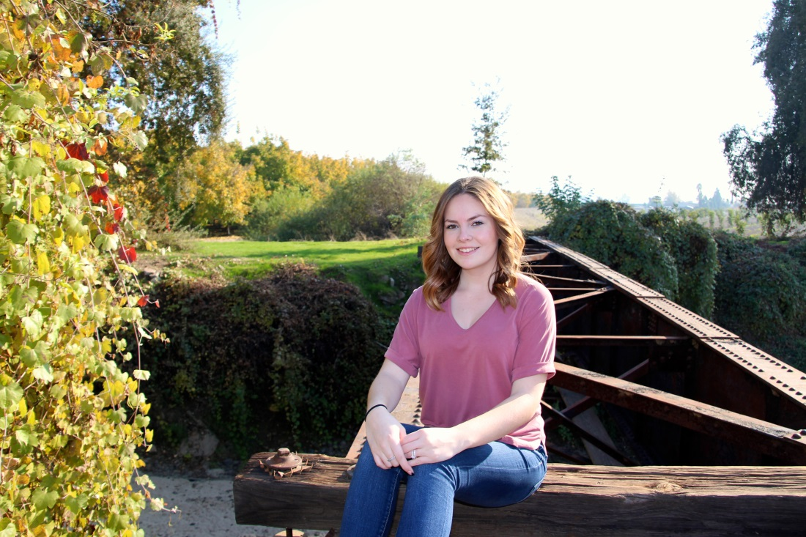
Sienna Doria

Slide 2
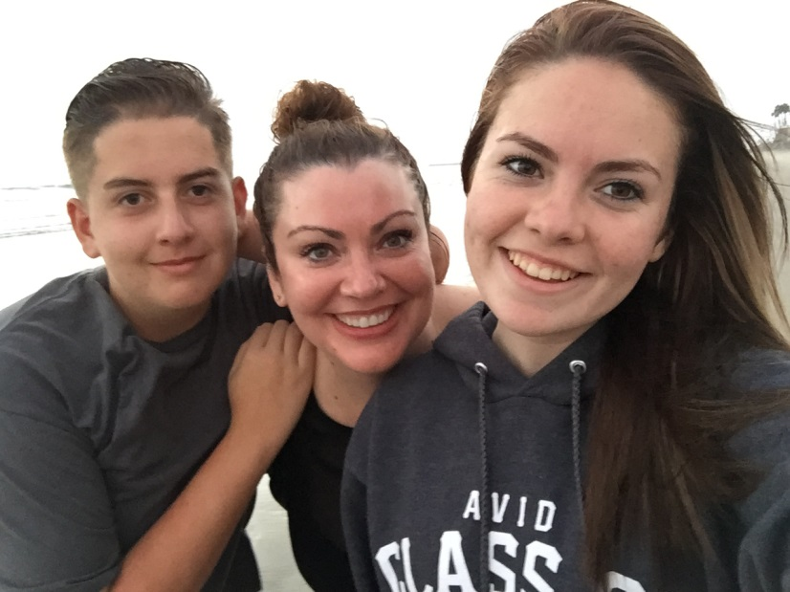
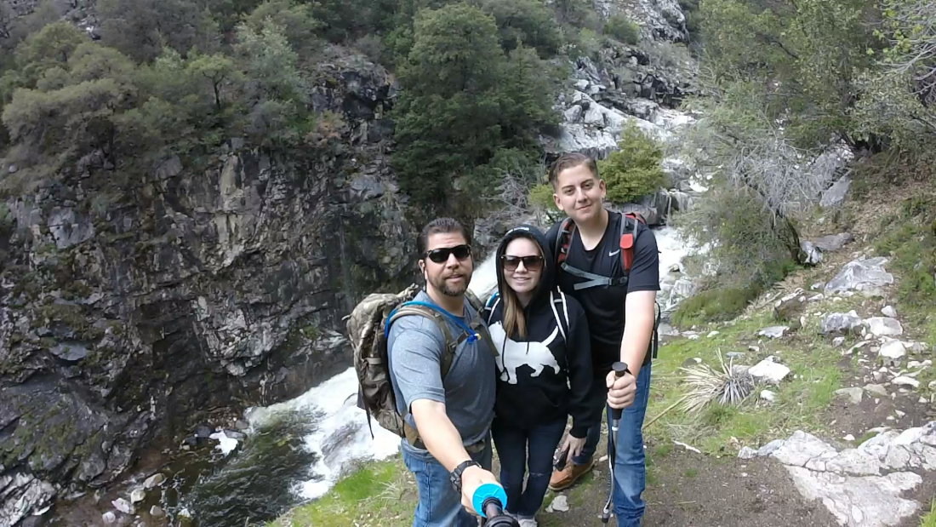
About me
1 brother
Photography
Parents divorce

Slide 3
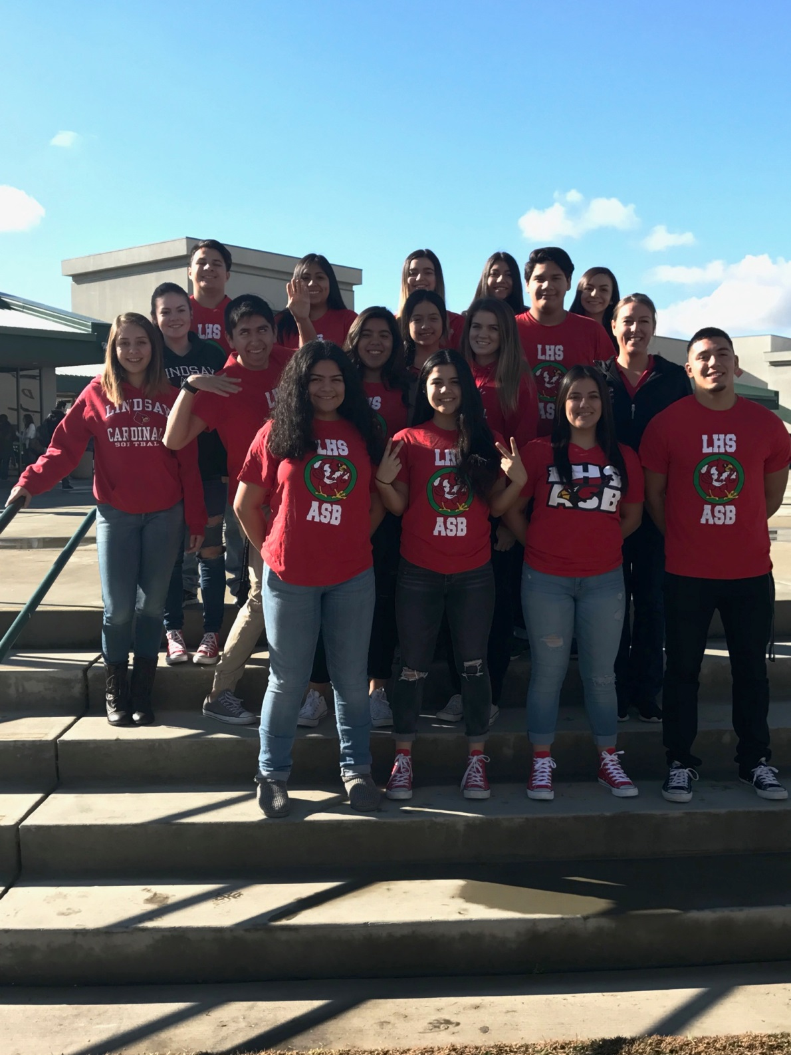
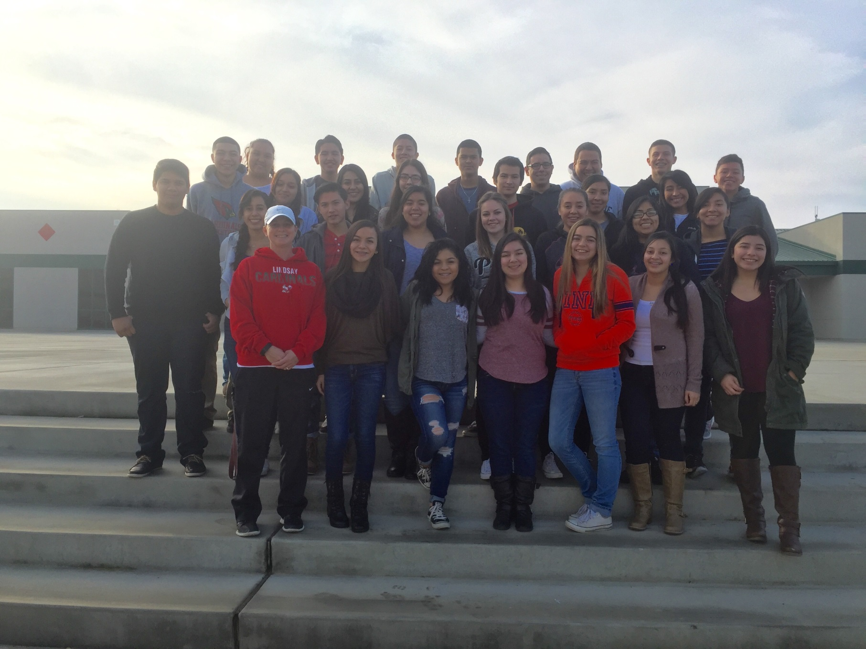
High school experience
Clubs and activities
AVID, Key club, school site council representative, ASB
AVID Trip
Depression
I’m capable of more than I let myself believe

Slide 4
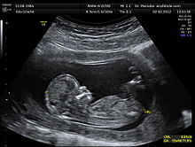
Job shadow
Ultrasound technician
More than half of it is transvaginal ultrasounds
She made her patients feel comfortable

Slide 5
Pathway
Spanish
Helpful to speak multiple languages in any job field

Slide 6
Post- high school plans
Applied to three colleges
Parents support me and are willing to assist me financially
Short term- go to college and get good grades
Long term- registered nurse working in labor and delivery

Slide 7
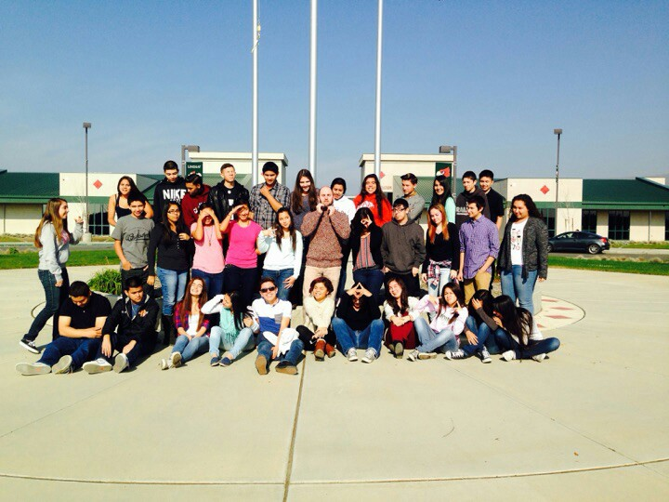
Leaving LHS
Influential teachers
Guss
PBS system
Accountability

Slide 8
Any questions?

